Slide 1
Angular v17, Kotlin, Spring, WebSocket, Redis
Studenti: Andrija Tošić 1711, Stefan Stojadinović 1713
Profesor: Aleksandar Milosavljević

Slide 2

Framework i platforma za razvoj single-page aplikacija
Jedan od tri najvećih frontend framework-ova, pored React-a i Vue-a
Blokovi koji čine Angular aplikaciju su: moduli, servisi, komponente i direktive
Servisi imaju provajdere i koriste dependency injection

Slide 3
(Standalone) komponente
@Component({
selector: 'app-document',
standalone: true,
imports: [CommonModule, RouterModule, MatIconModule, RtButtonComponent],
templateUrl: './document.component.html',
changeDetection: ChangeDetectionStrategy.OnPush
})
export class DocumentComponent implements AfterViewInit, OnDestroy {
http = inject(HttpClient);
injector = inject(Injector);
snackbar = inject(MatSnackBar);
route = inject(ActivatedRoute);
socketIOService = inject(SocketIoService);
documentService = inject(DocumentService);
@ViewChild('codeMirror') private cm!: ElementRef<HTMLDivElement>;
editor = new Editor();
destroy$ = new Subject<void>();
constructor() {
this.subscribeToSocketEvents();
this.subscribeToEditorEvents();
}
TypeScript klasa koja interaguje sa view-om (.html)
View sadrži komponentu i HTML template
Template je HTML ukombinovan sa data-binding sintaksom Angular-a

Slide 4
Servisi
@Injectable({
providedIn: 'root'
})
export class DocumentService {
private http = inject(HttpClient);
get(docId: string): Observable<Document> {
return this.http.get<Document>(`${Constants.API_URL}/document/${docId}`);
}
getAll(): Observable<Document[]> {
return this.http.get<Document[]>(`${Constants.API_URL}/document`);
}
create(name: string, language: string): Observable<Document> {
return this.http.post<Document>(
`${Constants.API_URL}/document`,
{ name, language },
Constants.HTTP_OPTIONS
);
}
}
Injectable klasa namenjena za pribavljanje podataka sa servera, promenu stanja aplikacije itd.
Servisima izbegavamo duplikaciju koda
Servis može da se napiše jednom i da se inject-uje u svim komponentama koje ga korsite

Slide 5
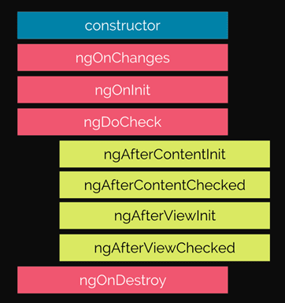
Lifecycle hooks
ngAfterViewInit(): void {
const id = this.route.snapshot.params['id'];
this.socketIOService
.connect(id)
.pipe(
mergeMap((socketId) =>
this.documentService.get(id).pipe(map((doc) => ({ socketId, doc })))
),
takeUntil(this.destroy$)
)
.subscribe(({ socketId, doc }) => {
this.editor.init(this.cm, doc, this.injector);
});
}
ngOnDestroy(): void {
this.editor.dispose();
this.destroy$.next();
this.socketIOService.disconnect();
}

Slide 6
@for i signali
<ng-container *ngIf="(documents$ | async) as documents;
else loadingTemplate">
<ng-container *ngIf="documents.length;
else placeholderTemplate">
<app-document-card
*ngFor="let document of documents; trackBy:
trackById"
[document]="document"
(onClick)="navigateToDocument(document.id)"
></app-document-card>
</ng-container>
</ng-container>
<ng-template #loadingTemplate>
Loading...
</ng-template>
<ng-template #placeholderTemplate>
Placeholder
</ng-template>
@for (document of this.documents(); track document.id) {
@defer {
<app-document-card
[document]="document"
(onClick)="this.router.navigate(['/document/' +
document.id])"
></app-document-card>
} @placeholder {
Placeholder
} @loading {
Loading...
} @error {
Something went wrong :(
}
}

Slide 7
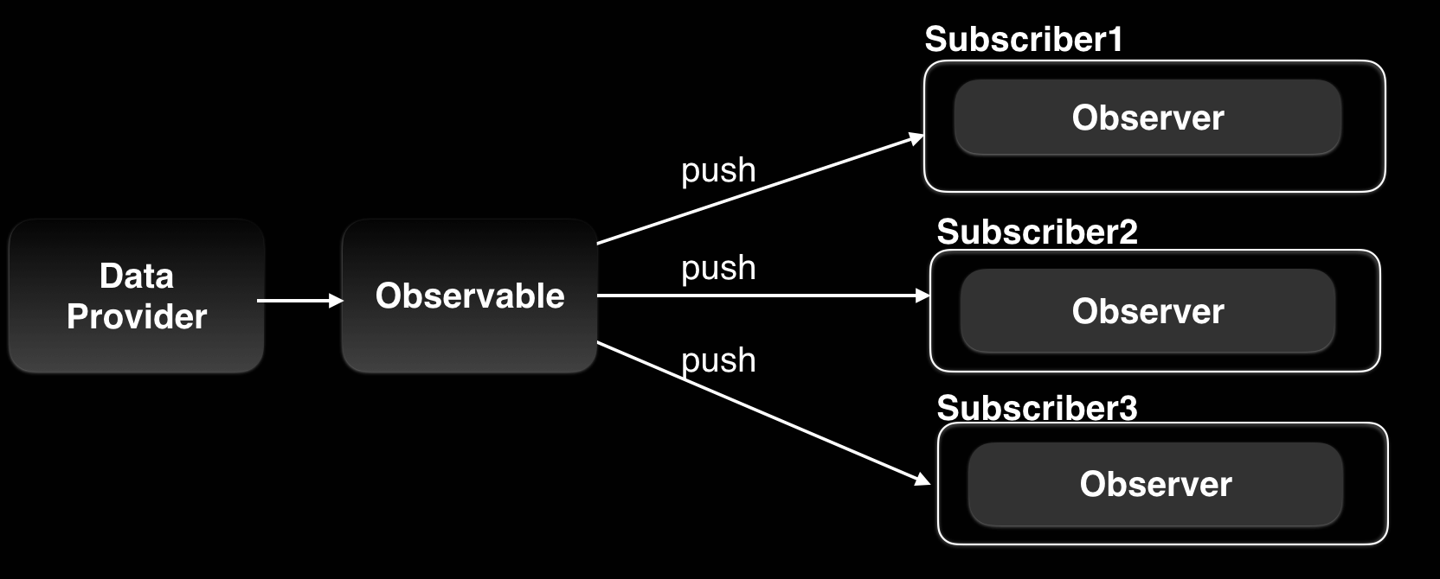
Obseravbles vs Signals

Slide 8
Obseravbles vs Signals
export class DocumentState {
private _pendingChangesQueue = new Queue<OperationWrapper>();
private _selections = signal(new Map<string, TextSelection>());
readonly doc = signal<Document>({
id: '',
content: 'Loading...',
name: 'Loading...',
revision: -1,
language: ''
});
get selections() {
return this._selections.asReadonly();
}
subscribeToEditorEvents() {
this.editor.selection$
.pipe(takeUntil(this.destroy$))
.subscribe((selection) => {
this.socketIOService.emit<TextSelection>('selection', selection);
});
this.editor.dequeuedOperation$
.pipe(
takeUntil(this.destroy$),
switchMap((operationWrapper) =>
this.socketIOService.emitWithAck<OperationWrapper, OperationAck>(
'operation',
operationWrapper
)
)
)
.subscribe((ack) => {
if (ack.revision === -1) {
this.documentService
.get(this.editor.documentState.doc().id)
.subscribe((doc) => {
this.editor.setDocument(doc);
});
} else {
this.editor.ackHandler(ack);
}
});
}
effect(() => {
const selectionValues = [...selections().values()];
const cursorDecorations = selectionValues
.filter((selection) => selection.from === selection.to)
.map((selection) => {
return {
from: selection.from,
to: selection.to,
value: Decoration.widget({
side: -1,
block: false,
widget: new CursorWidget(selection.performedBy)
})
};
});

Slide 9
Routing, guards
export const authGuard: CanActivateFn = (route, state) => {
const dialog = inject(MatDialog);
const user = window.localStorage.getItem('user');
if (user == null) {
dialog
.open(UsernameInputDialogComponent)
.afterClosed()
.subscribe((data: UsernameInputDialogData) => {
localStorage.setItem('user', data.username);
});
}
return of(true);
};
export const routes: Routes = [
{ path: '', redirectTo: 'home', pathMatch: 'full' },
{
path: '',
component: NavigationComponent,
canActivate: [authGuard],
children: [
{ path: 'home', component: HomeComponent },
{ path: 'document/:id', component:
DocumentComponent },
],
},
{
path: '**',
redirectTo: 'home',
},
];

Slide 10
Pipes
<p
class="block text-base antialiased leading-relaxed text-inherit text-gray-500"
>
{{
document.content.length > 20
? (document.content | slice: 0 : 18) + "..."
: document.content
}}
</p>

Slide 11
@Input
@Component({
selector: 'app-document-card',
standalone: true,
imports: [AngularMaterialModule, SlicePipe],
templateUrl: './document-card.component.html'
})
export class DocumentCardComponent {
@Input('document') document!: Document;
@Output('onClick') onClick = new EventEmitter<void>();
}
@for (document of this.documents(); track document.id) {
@defer {
<app-document-card
[document]="document"
(onClick)="this.router.navigate(['/document/' + document.id])"
></app-document-card>
} @placeholder {
Placeholder
} @loading {
Loading...
} @error {
Something went wrong :(
}
}

Slide 12
Forme
<form (ngSubmit)="onConfirm()" [formGroup]="form">
<div class="..." >
<label for="name">Document name</label>
<input
type="text"
formControlName="name"
placeholder="Name"
class="..."
/>
<label for="language">Language</label>
<select
formControlName="language"
name="language"
class="..."
>
@for (language of languages; track language.name) {
<option [selected]="$first" [value]="language.name">
{{ language.name }}
</option>
}
</select>
<button class="..." type="submit">Submit</button>
</div>
</form>
form = new FormGroup({
name: new FormControl('', {
nonNullable: true,
validators: [Validators.required]
}),
language: new FormControl(this.languages[0].name, {
nonNullable: true,
validators: [Validators.required]
})
});
onConfirm() {
const { name, language } = this.form.getRawValue();
if (!language || !name) {
return;
}
this.dialogRef.close({ name, language });
}

Slide 13
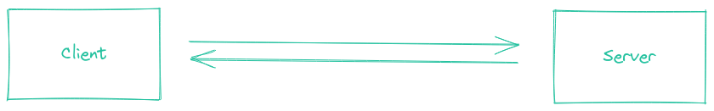
WebSocket (socket.io)
Socket.IO je biblioteka koja omogućava nisko kašnjenje, dvosmernu komunikaciju i komunikaciju zasnovanu na događajima između klijenta i servera.
Socket.IO veza se može uspostaviti sa različitim transportima niskog nivoa:
HTTP long polling
WebSocket
WebTransport
Socket.IO će automatski izabrati najbolju dostupnu opciju, u zavisnosti od:
Mogućnosti pretraživača
Mreže (neke mreže blokiraju WebSocket i/ili WebTransport veze)

Slide 14
WebSocket (socket.io)
export type SocketEvent =
| 'operation'
| 'connect'
| 'disconnect'
| 'selection'
| 'user_joined_doc'
| 'user_left_doc';
@Injectable({
providedIn: 'root'
})
export class SocketIoService {
private socket: Socket | undefined;
private connect$ = new Subject<string>();
public operation$ = new Subject<OperationWrapper>();
public selection$ = new Subject<TextSelection>();
public userJoin$ = new Subject<UserInfo>();
public userLeave$ = new Subject<UserInfo>();
connect(docId: string) {
const username = localStorage.getItem('user')!;
this.socket =
io(`${Constants.WS_URL}?docId=${docId}&username=${username}`);
this.socket.on('connect', () => {
console.log('Socket.IO connected:', this.socket!.id);
this.connect$.next(this.socket!.id!);
});
this.socket.on('acknowledge', () => {
console.log('ack');
});
this.socket.on('disconnect', (reason) => {
console.log('Socket.IO disconnect reason:', reason);
});
this.setupSocketEvent(this.operation$, 'operation', (op) =>
console.log('Socket operation response:', op)
);
this.setupSocketEvent(this.selection$, 'selection');
this.setupSocketEvent(this.userJoin$, 'user_joined_doc');
this.setupSocketEvent(this.userLeave$, 'user_left_doc');
return this.connect$;
}

Slide 15

Kotlin
Statički tipizirani, objektno orijentisan programski jezik razvijen od strane JetBrains-a.
Potpuno je interoperabilan s Javom, omogućavajući zajedničko korišćenje sa postojećim Java kodom.
Koncizan jezik - manje boilerplate koda od ekvivalentnog u Javi
Kompajlira se u native binarne datoteke, JS, WASM, JVM byte code
Notes:
Jedndostavno je moguće pozivati kotli kod iz java, i java koda iz kotlina
Kompajlira se u nativne bin datoteke i moze se izvrsavati bez virtuelne masine, korisno za iOS, embedded, U js - omogucava pisanje frontend koda, slicno za wasm
Kompajlira se u java bytecode i izvasava na JVM

Slide 16
Koncizna sintaksa
Nudi koncizniju i izražajniju sintaksu, eliminiše boilerplate kod i povećava čitljivost
Zaključivanja tipova, nullable tipovi, lambda izrazi, extension funkcije
Moćne standardne biblioteke
Imenovani argumenti, podrazumevane vrednosti, destruktuiranje objekata
Smart cast
Data klase
Overloading operatora
String interpolacija
data class DocumentPreview(
val id: String,
val name: String,
val language: String,
val content: String,
val updatedAt: ZonedDateTime
)
val (origin, payload) = message
if (origin != excludeOrigin) {
listener.onMessage(topicName, payload)
}
return redisson.getMap<String, String>("$DOCUMENT_USERS:$docId")
Notes:
Pojo sa getterima, setterima, hashcode, copy,

Slide 17
Null safety
Nullable i non-nullable tipovi
Kompajler sprečava neproverene pozive nad nullable promenljivama
Promenljive podrazumevano nisu nullable
Nullable promenljive označene su ? (upitnikom)
Operatori: ?. | ?: | as?
1
val snapshot: DocumentState? = documentRepo.getDocument(docId)
val document: DocumentState = null; // kompajler nece dozvoliti
var snippet = snapshot?.content?.substring(0, snippetLen.coerceAtMost(snapshot.content.length))
if (snapshot != null)
snippet = snapshot.content
val buffer = StringBuffer(initialContent ?: "")
2
3
4
5
"I call it my billion-dollar mistake.", Tony Hoare
Notes:
An explicit call to throw NullPointerException().
Usage of the !! operator that is described below.
Data inconsistency with regard to initialization, such as when:
An uninitialized this available in a constructor is passed and used somewhere (a "leaking this").
A superclass constructor calls an open member whose implementation in the derived class uses an uninitialized state.
Java interoperation:
Attempts to access a member of a null reference of a platform type;
Nullability issues with generic types being used for Java interoperation. For example, a piece of Java code might add null into a Kotlin MutableList<String>, therefore requiring a MutableList<String?> for working with it.
Other issues caused by external Java code.

Slide 18
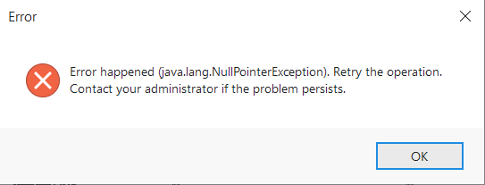
Null safety (2)
Do null exception-a ipak može doći:
Operator !!
val length = operation.operand.length
val lengthNpe = operation.operand!!.length
Eksplicitan poziv throw NullPointerException()
Neslaganje podataka u vezi sa inicijalizacijom
Java interoperabilnost - Java kod može dodati null u Kotlin MutableList<String>.
Koristiti MutableList<String?>

Slide 19
Funkcije proširenja (Extension functions)
Dodaju funkcionalnosti klasama/interfejsima bez potrebe za nasleđivanjem
private inline fun <reified T, reified M : RedisMessage<T>> RedissonClient.addListener(
topicName: String,
excludeOrigin: String,
listener: MessageListener<T>) {
this.getTopic(topicName, TypedJsonJacksonCodec(object : TypeReference<M>() {}, mapper))
.addListener(M::class.java) { _, message ->
val (origin, payload) = message
if (origin != excludeOrigin) {
listener.onMessage(topicName, payload)
}
}
}
Notes:
Kotlin provides the ability to extend a class or an interface with new functionality without having to inherit from the class or use design patterns such as Decorator. This is done via special declarations called extensions.
For example, you can write new functions for a class or an interface from a third-party library that you can't modify. Such functions can be called in the usual way, as if they were methods of the original class. This mechanism is called an extension function. There are also extension properties that let you define new properties for existing classes.
You can only use reified in combination with an inline function. By doing so, you instruct the compiler to copy the function's bytecode to every spot the function is invoked from (the compiler "inlines" the function). When you call an inline function with reified type, the compiler has to be able to know the actual type passed as a type argument so that it can modify the generated bytecode to use the corresponding class directly. Therefore a call like myVar is T becomes myVar is String in the bytecode (if the type argument is String).
https://stackoverflow.com/questions/45949584/how-does-the-reified-keyword-in-kotlin-work

Slide 20

Framework za razvoj aplikacija koje se izvršavaju na JVM
Opensource
Spring Boot ubrzava razvoj Spring aplikacija
Production-ready
Executable jar, actuator
Spring boot starteri
implementation("org.springframework.boot:spring-boot-starter-security")
implementation("org.springframework.boot:spring-boot-starter-web")i
Aktuelna verzija 3.2.2 (Spring 6.1.3)
Notes:
Spring Boot starters are dependency descriptors that simplify the process of including libraries in your project. They provide a quick and easy way to add common functionality to your application, without the need to manually configure each library. Spring Boot starters are available for a wide range of applications, including web, data, testing, and security.

Slide 21
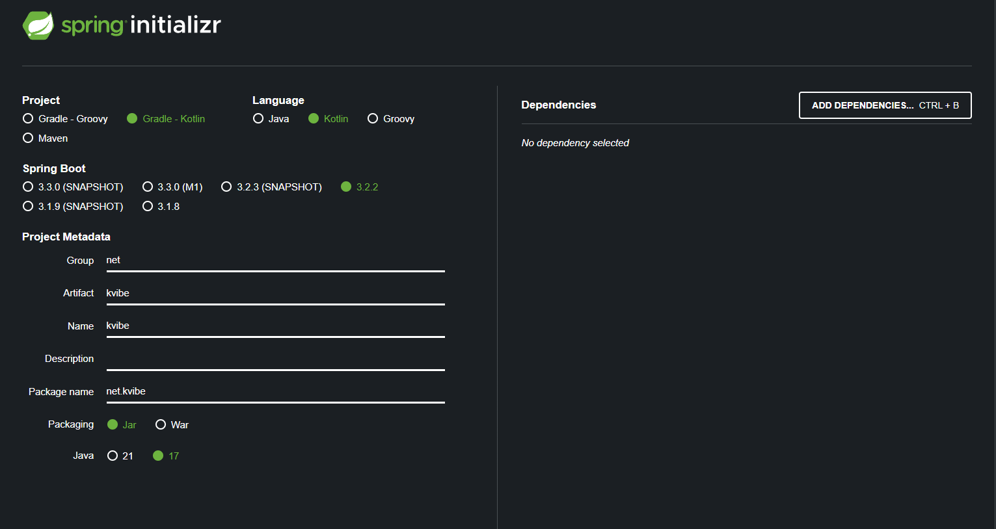
Spri
Notes:
One of the ways to Bootstrapping a Spring Boot application is by using Spring Initializer. To do this, you will have to visit the Spring Initializer web page http://start.spring.io/ and choose your Build, Spring Boot Version and platform. Also, you need to provide a Group, Artifact and required dependencies to run the application. Observe the following screenshot that shows an example where we added the springboot-starter-web dependency to write REST Endpoints. Once you provided the Group, Artifact, Dependencies, Build Project, Platform and Version, click Generate Project button. The zip file will download and the files will be extracted. This section explains you the examples by using both Maven and Gradle.

Slide 22
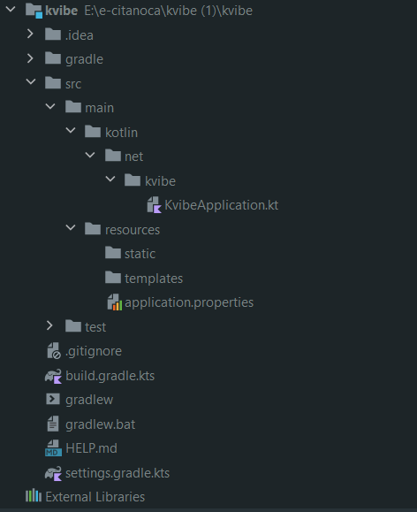
Ulazna tačka aplikacije
package net.kvibews
import org.springframework.boot.autoconfigure…
import org.springframework.boot.runApplication
@SpringBootApplication
class KvibeWsApplication
fun main(args: Array<String>) {
runApplication<KvibeApplication>(*args)
}
Notes:
The @SpringBootApplication Annotation The second class-level annotation is @SpringBootApplication. This annotation is known as a metaannotation, it combines @SpringBootConfiguration, @EnableAutoConfiguration and @ComponentScan. Of those, the annotation we’re most interested in here is @EnableAutoConfiguration. @EnableAutoConfiguration tells Spring Boot to “guess” how you want to configure Spring, based on the jar dependencies that you have added. Since spring-boot-starter-web added Tomcat and Spring MVC, the auto-configuration assumes that you are developing a web application and sets up Spring accordingly. Starters and Auto-configuration Auto-configuration is designed to work well with “Starters”, but the two concepts are not directly tied. You are free to pick and choose jar dependencies outside of the starters. Spring Boot still does its best to auto-configure your application. The “main” Method The final part of our application is the main method. This is a standard method that follows the Java convention for an application entry point. Our main method delegates to Spring Boot’s SpringApplication class by calling run. SpringApplication bootstraps our application, starting Spring, which, in turn, starts the auto-configured Tomcat web server. We need to pass MyApplication.class as an argument to the run method to tell SpringApplication which is the primary Spring component. The args array is also passed through to expose any command-line arguments.

Slide 23
Beans
@Bean
@Scope(ConfigurableBeanFactory.SCOPE_PROTOTYPE)
fun logger(injectionPoint: InjectionPoint): Logger {
return LoggerFactory.getLogger(
injectionPoint.methodParameter?.containingClass ?: injectionPoint.field?.declaringClass
)
}
Objekti kojima upravlja Spring IoC container
Aplikacioni kontekst
@ComponentScan
Klasne anotacije prepoznate skeniranjem:
@Component
@Service
@Repository
@RestController
@Bean - anotacija na nivou metoda
@Repository
class DocumentRepository(
private val redisson: RedissonClient,
private val mapper: ObjectMapper,
private val properties: ApplicationProperties
) {
}
@Autowired
lateinit var documentService: DocumentService
Notes:
@Controller annotation is an annotation used in Spring MVC framework (the component of Spring Framework used to implement Web Application). The @Controller annotation indicates that a particular class serves the role of a controller. The @Controller annotation acts as a stereotype for the annotated class, indicating its role. The dispatcher scans such annotated classes for mapped methods and detects @RequestMapping annotations.
Componente omogucava spring to detektuje i konfigurise
@bean se koristi da eksplicitno deklarise bean, umesto da se ostavi ta odgovornost sprin.
To do dependency injection, Spring creates a so-called application context.
During startup, Spring instantiates objects and adds them to the application context. Objects in the application context are called “Spring beans” or “components”.
Spring resolves dependencies between Spring beans and injects Spring beans into other Spring beans' fields or constructors.
The process of searching the classpath for classes that should contribute to the application context is called component scanning.
Kada se pokrece spring

Slide 24
Auto-konfiguracija
Spring Boot na osnovu prisutnih zavisnosti konfiguriše aplikaciju
Konfiguraciju vrši na osnovu propertija aplikacije
properties, yml, env promenljive, command-line argumenti
Jednostavno predefinisanje Spring konfigurisanih Beanova
Isključivanje klase iz konfiguracije
@EnableAutoConfiguration(exclude={DataSourceAutoConfiguration.class})
Notes:
If you create a Spring Web application, an embedded version of Tomcat is included. In a typical Java application, you would need to set up and configure Tomcat yourself. However, since Tomcat is on the classpath, Spring automatically configures it and provides sensible defaults such as setting the default port to 8080. You can always change the port through your own configuration, but Spring sets this default to get you up and running quickly.

Slide 25
Kontroleri
@RestController
@RequestMapping("/document")
class DocumentController(val documentService: DocumentService) {
@GetMapping("/preview")
fun getDocumentOverviews(): ResponseEntity<List<DocumentPreview>> {
return ResponseEntity.ok(documentService.getDocumentPreviews())
}
@GetMapping("/preview/{id}")
fun getDocumentOverview(@PathVariable id: String): ResponseEntity<DocumentPreview> {
return ResponseEntity.ok(documentService.getDocumentOverview(id))
}
@GetMapping("/{id}")
fun getDoc(@PathVariable id: String): ResponseEntity<DocumentState> {
return ResponseEntity.ok(documentService.getDocument(id))
}
@PostMapping
fun createDoc(@RequestBody document: DocumentDTO.Create): ResponseEntity<DocumentState> {
return ResponseEntity.ok(documentService.createDocument(document))
}
}
Notes:
Because Jackson 2 is on the classpath, Spring’s MappingJackson2HttpMessageConverter is automatically chosen to convert the Greeting instance to JSON.
The paths specified by the @RequestMapping annotation are managed internally via the HandlerMapping interface.
The URLs structure is naturally relative to the DispatcherServlet itself – and determined by the servlet mapping.
Thus, if the DispatcherServlet is mapped to ‘/’, then all mappings are going to be covered by that mapping.
If, however, the servlet mapping is ‘/dispatcher‘ instead, then any @RequestMapping annotations are going to be relative to that root URL.
. The dispatcher scans such annotated classes for mapped methods and detects @RequestMapping annotations. Let’s understand all of these by example.
@RequestBody annotation maps the HttpRequest body to a transfer or domain object, enabling automatic deserialization

Slide 26
Kontroleri
@RestController - @Controller + @ResponseBody
@RequestMapping - mapiranje putanja
@RequestMapping("/{name:[a-z-]+}-{ext:\\.[a-z]+}", method = HttpMethod.GET)
@GetMapping
@PostMapping
@PutMapping
@DeleteMapping
@PatchMapping
@RequestBody
@RequestParam
@PathVariable
Notes:
For example, @RequestParam is used to capture query parameters or form parameters from the URL, while @PathVariable is used to capture values from the URL path.

Slide 27
Spring Security
@Bean
fun corsConfigurationSource(props: ApplicationProperties): CorsConfigurationSource = CorsConfiguration()
.apply {
allowedOrigins = props.allowedOrigins
allowedMethods = listOf("*")
allowedHeaders = listOf("*")
}
.let { corsConfig ->
UrlBasedCorsConfigurationSource()
.apply { registerCorsConfiguration("/**", corsConfig) }
}
@Bean
fun filterChain(http: HttpSecurity): SecurityFilterChain {
http {
cors { }
csrf { disable() }
authorizeRequests {
authorize("/**", permitAll)
}
}
return http.build()
}

Slide 28
Spring cloud config
Server-side i client-side podrška za eksternu konfiguraciju kod distribuiranih aplikacija
Centralizovano upravljanje eksternim podešavanjima za aplikacije u svim okruženjima (dev, prod,...)
Cloud-config-server pruža HTTP API za pristup konfiguracionim resursima
Za skladištenje resursa podrazumevano se koristi git
Laka konfiguracija upotrebom Spring Boot framework-a
spring:
application:
name: kvibe-ws
config:
import: optional:configserver:${CLOUD_CONFIG_SERVER}
spring:
security:
user:
password: ${SPRING_CLOUD_PASSWORD}
name: admin
application:
name: cloud-configurer
cloud:
config:
server:
git:
uri: ${GIT_REPO_URI}
private-key: ${GIT_PRIVATE_KEY}
strict-host-key-checking: false
ignore-local-ssh-settings: true
search-paths:
- 'env_{profile}'

Slide 29
SocketIO
Java implementacija SocketIO servera
Baziran na Netty framework-u
Podržava ack, binarni ack, websocket transport
@Bean
fun socketIOServer(): SocketIOServer {
val config = com.corundumstudio.socketio.Configuration().apply {
hostname = socketIOProperties.host
port = socketIOProperties.port
origin = socketIOProperties.origin
}
val socketIOServer = SocketIOServer(config)
socketIOServer.start()
return socketIOServer
}

Slide 30

REmote DIctionary Server
In-memory key-value baza podataka
Ključevi su stringovi
Vrednosti String, JSON, liste, hash, sortirani skupovi, bitmape…
Atomične operacije nad ovim tipovima
Može se koristiti kao baza (podržava perzistenciju), za keširanje, message broker
Pogodan za podatke koji se brzo menjaju
TTL za ključeve

Slide 31
Redisson
Redis java klijent
Sinhroni, asinhroni i reaktivni pristup
Podržava rad sa svim redis strukturama
Distribuirani lockovi
Izvršenje skripti
Batch naredbe
@Bean
fun redissonClient(): RedissonClient {
val config = Config()
config.useSingleServer().apply {
address = "redis://${props.host}:${props.port}"
password = props.password
timeout = props.timeout
clientName = props.clientName
connectionPoolSize = props.connectionPoolSize
connectionMinimumIdleSize = props.connectionMinimumIdleSize
dnsMonitoringInterval = props.dnsMonitoringInterval
}
return Redisson.create(config)
}

Slide 32
fun setDocument(docId: String, value: DocumentState, preview: DocumentPreview) {
val batch = redisson.createBatch(
BatchOptions.defaults().executionMode(BatchOptions.ExecutionMode.REDIS_WRITE_ATOMIC)
)
batch.getJsonBucket("$DOCUMENT:$docId", documentCodec)
.setAsync(value, properties.operation.staleDocumentExpiry, TimeUnit.SECONDS)
batch.getJsonBucket("$DOCUMENT_PREVIEW:$docId", docPreviewCodec)
.setAsync(preview, properties.operation.staleDocumentExpiry, TimeUnit.SECONDS)
batch.execute()
}
fun getActiveUserBySessionId(docId: String, sessionId: UUID): String? {
return redisson.getMap<String, String>("$DOCUMENT_USERS:$docId")[sessionId.toString()]
}
fun setDocumentPreview(docId: String, overview: DocumentPreview) {
redisson.getJsonBucket("$DOCUMENT_PREVIEW:$docId", docPreviewCodec)
.set(overview, properties.operation.staleDocumentExpiry, TimeUnit.SECONDS)
}

Slide 33
Atomično izvršenje Lua skripti
return redisson.getScript(StringCodec.INSTANCE).eval(
RScript.Mode.READ_WRITE,
"""
local r = tonumber(ARGV[1]);
local currentDoc = redis.call("JSON.GET", KEYS[1]);
if currentDoc then
local docJson = cjson.decode(currentDoc);
if docJson.revision == r then
redis.call('JSON.SET', KEYS[1], '$', ARGV[2]);
redis.call('JSON.SET', KEYS[2], '$.content', ARGV[3]);
redis.call('EXPIRE', KEYS[1], tonumber(ARGV[4]));
redis.call('EXPIRE', KEYS[2], tonumber(ARGV[4]));
return true;
else
return false;
end;
else
return false;
end;
""",
RScript.ReturnType.BOOLEAN,
listOf("${DOCUMENT}:${docId}", "${DOCUMENT_PREVIEW}:${docId}"),
expectedRevision.toString(),
mapper.writeValueAsString(snapshot),
mapper.writeValueAsString(contentPreview),
properties.operation.staleDocumentExpiry.toString()
)

Slide 34
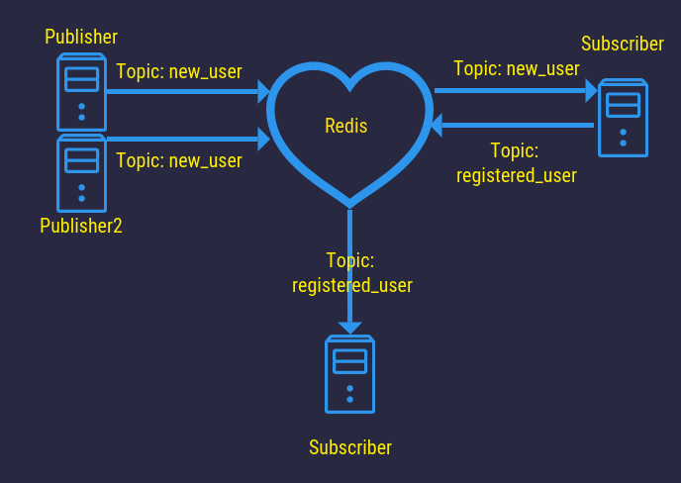
Redis pub/sub
Message broker
Nema perzistencije poruka
Poruke se šalju na kanale
Svi subscriberi primaju poruku
SUBSCRIBE
UNSUBSCRIBE
PSUBSCRIBE
PUNSUBSCRIBE
PUBLISH

Slide 35
private inline fun <reified T, reified M : RedisMessage<T>> RedissonClient.addListener(
topicName: String,
excludeOrigin: String,
listener: MessageListener<T>) {
this.getTopic(topicName, TypedJsonJacksonCodec(
object : TypeReference<M>() {}, mapper)).addListener(M::class.java) { _, message ->
val (origin, payload) = message
if (origin != excludeOrigin) {
listener.onMessage(topicName, payload)
}
}
}

Slide 36
Redisson pub/sub
@Component
class RedisTopicListenerRegistry(
redissonClient: RedissonClient,
origin: RedisOriginProvider,
val mapper: ObjectMapper,
val eventDispatcherService: EventDispatcherService,
) {
init {
redissonClient.addListener(RedisTopicName.DOC_OPERATION_PROCESSED, origin.value, onOperation())
redissonClient.addListener(RedisTopicName.DOC_SELECTION, origin.value, onSelection())
redissonClient.addListener(RedisTopicName.DOC_USER_JOINED, origin.value,
onUserJoined())
redissonClient.addListener(RedisTopicName.DOC_USER_LEFT, origin.value, onUserLeft())
}

Slide 37
private fun onOperation(): MessageListener<OperationWrapper> {
return MessageListener { _, payload ->
eventDispatcherService.dispatchToWSRoom(payload)
}
}
private fun onSelection(): MessageListener<TextSelection> {
return MessageListener { _, payload ->
eventDispatcherService.dispatchToWsRoom(payload.docId, WsEventName.SELECTION, payload)
}
}
private fun onUserJoined(): MessageListener<DocumentDTO.UserInfo> {
return MessageListener { _, payload ->
eventDispatcherService.dispatchToWsRoom(payload.docId, WsEventName.USER_JOINED_DOC, payload)
}
}
private fun onUserLeft(): MessageListener<DocumentDTO.UserInfo> {
return MessageListener { _, payload ->
eventDispatcherService.dispatchToWsRoom(payload.docId, WsEventName.USER_LEFT_DOC, payload)
}
}

Slide 38
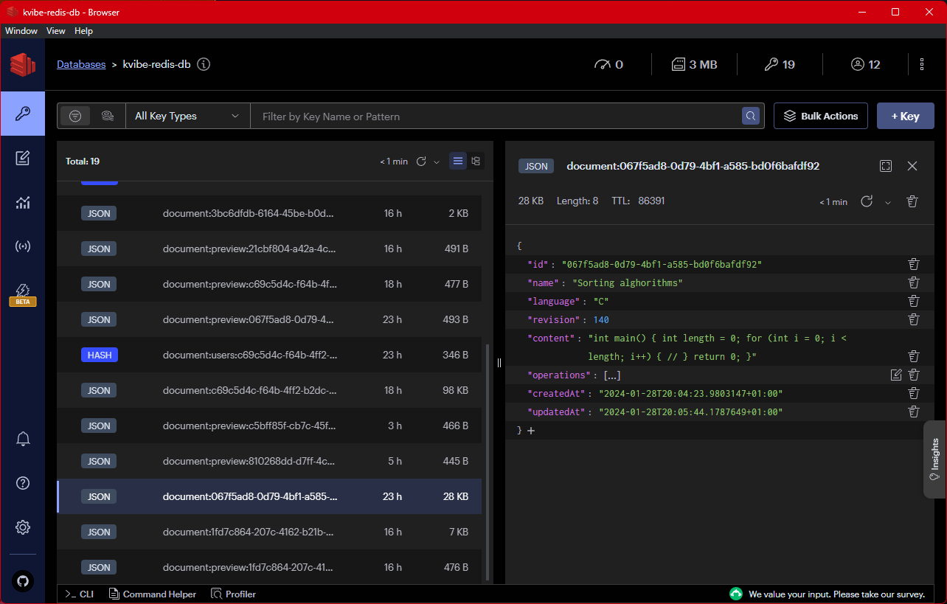

Slide 39

Demo

